Slide 1

UNIT 4B
SORRY! CAN YOU REPEAT THAT, PLEASE?

Slide 2
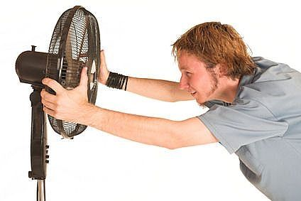
CONVERSATION
A: Excuse me! What do you need?
B: I need a fan.
A: Sorry, can you repeat that, please?
B: A FAN... I need a fan.
A: Got it. And do you need a lamp?
B: No I don’t need a lamp.

Slide 3
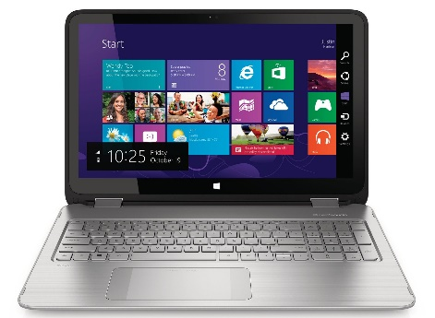
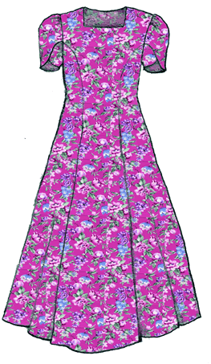
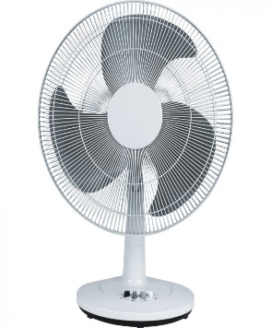
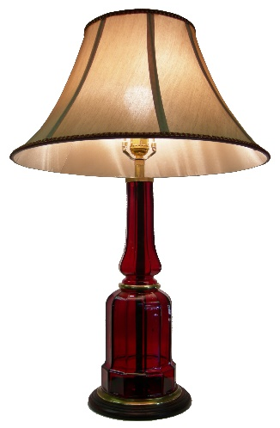
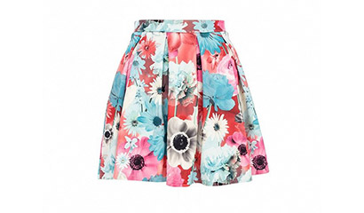
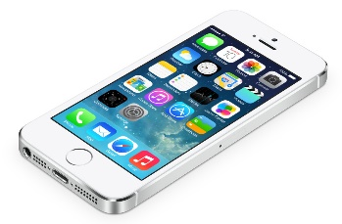
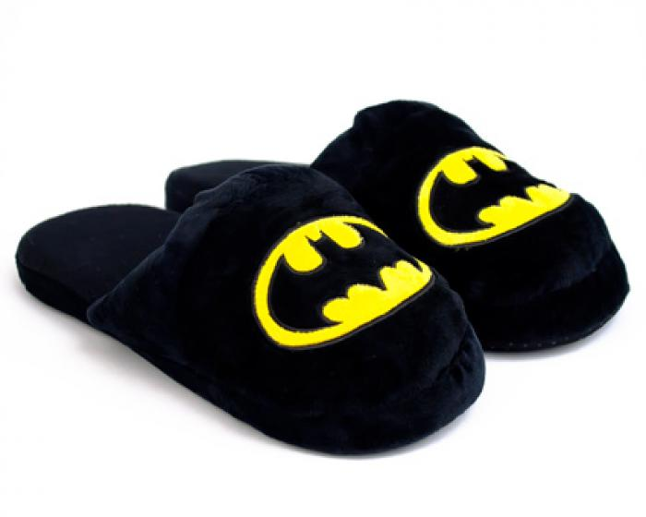
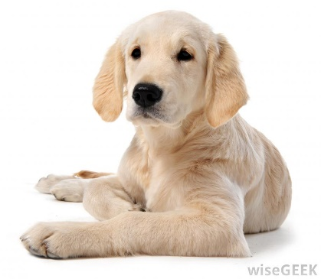

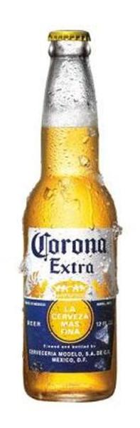
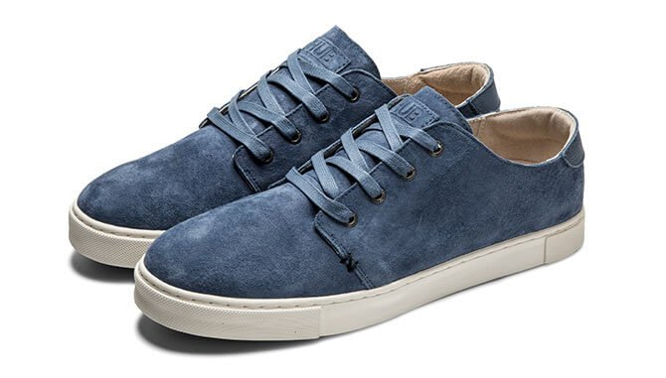
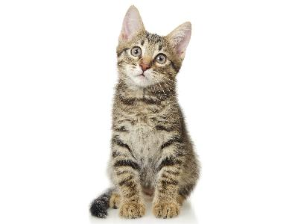
PRACTICE
Turn on
Like
Iron
Take off
Feed
Want

Slide 4
PRACTICE
build | houses, bridges
lock | the door, the window
turn on | the radio, the TV
smoke | a cigar, a cigarette
tie | a bag, a box
burn | the chair, the shelf
unlock | the gate, the suitcase
turn off | the light, the fan
break | a plate, a glass
take off | my slippers, my shoes
chase | a dog, a mouse
pull | the chair, the desk
serve | coffee, tea
hit | the ceiling, the wall
put on | a hat, a scarf
catch | a bus, a taxi
push | the sofa, the table
review | the lessons, my homework
beat | an egg, the drum
bite | an apple, a potato
shoot | the bird, the goose
sign | a letter, a contract
stop | the music, the game
kick | the ball, the rock
love | animals, flowers
have | a watch, a bracelet
wash | my coat, my dress
clean | the kitchen, the chair
carry | a picture, a map
sweep | the wall, the floor
iron | my T-shirts, my ties
open | a box, the windows
close | a book, a notebook
cook | rice, soup
feed | the dog, the cat
peel | tomatoes, potatoes

